Slide 1
Scratch 3.0: Changing Backdrops
I can...
Insert backdrops
Change backdrops
Use sensing commands
Backdrops
Sensing
Images by Krista Wallden
Computer Creations

Slide 2


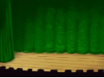
Starter
Which backdrop suits the sentences below:
I will perform my school play today
It is a lovely day outside
Do you want to come to my party?

Slide 3
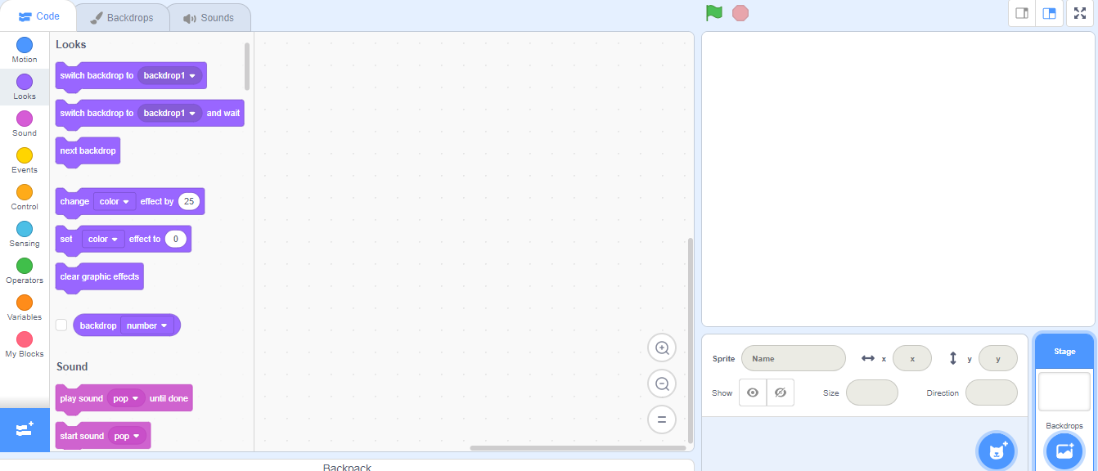
Task 1: Hot or Cold
2. Click on Backdrops
1. Click on Stage
3. Click on Choose Backdrop from library.

Slide 4
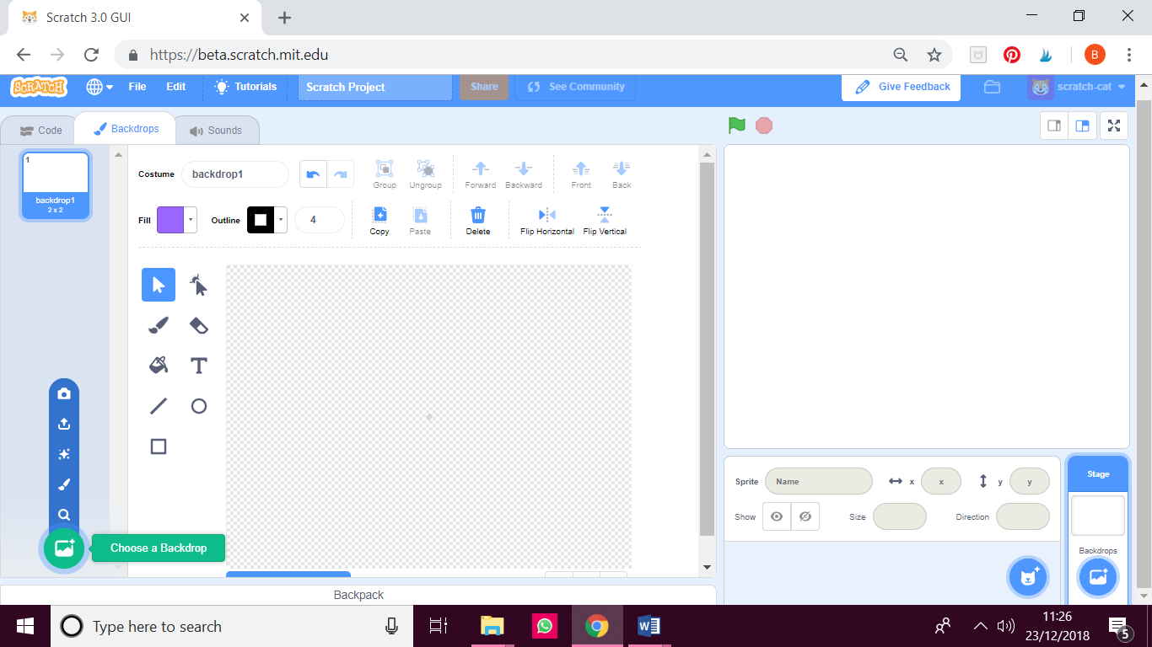
Task 1: Hot or Cold
4. Click ‘Choose a Backdrop’ and then search for the backdrop called ‘Winter’ and select it.
5. Repeat step 4 to import the ‘Beach Malibu’ backdrop

Slide 5
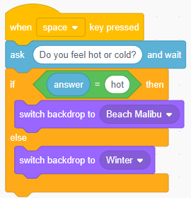
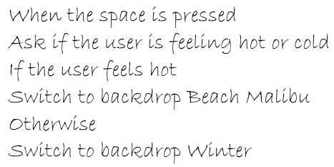
Task 1: Hot or Cold
Turn the following instructions into Scratch blocks
Answer

Slide 6
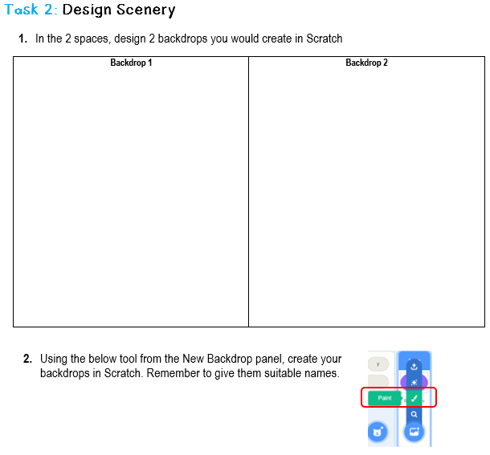
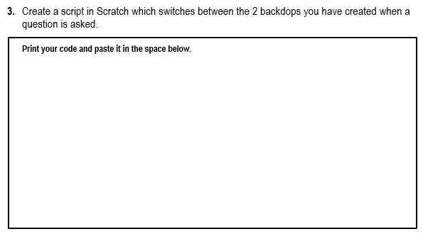
Task 2: Design Scenery
Complete the following task on your worksheet

Slide 7
Plenary
Draw around your hand on a piece of paper. On each finger and thumb, explain what you have learnt about backdrops in the lesson today.

